Slide 1
Lecture 5: Marks and Channels
DS 4200
Spring 2023
Prof. Ab Mosca (they/them)
Northeastern University
Slides and inspiration from Cody Dunne, Michelle Borkin, Dylan Cashman, Krzysztof Gajos, Hanspeter Pfister,
Miriah Meyer, Jonathan Schwabish, and David Sprague

Slide 2
Last Class
We:
Reviewed task abstraction
Practiced interviewing domain experts
Any Questions?

Slide 3
Today
Marks and Channels

Slide 4
Visualization Design Process
From Munzner’s book

Slide 5
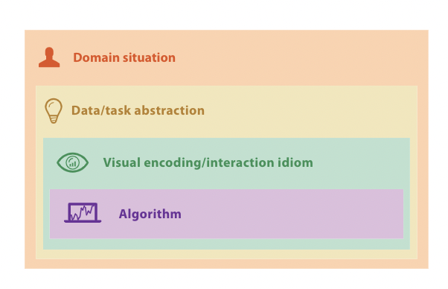
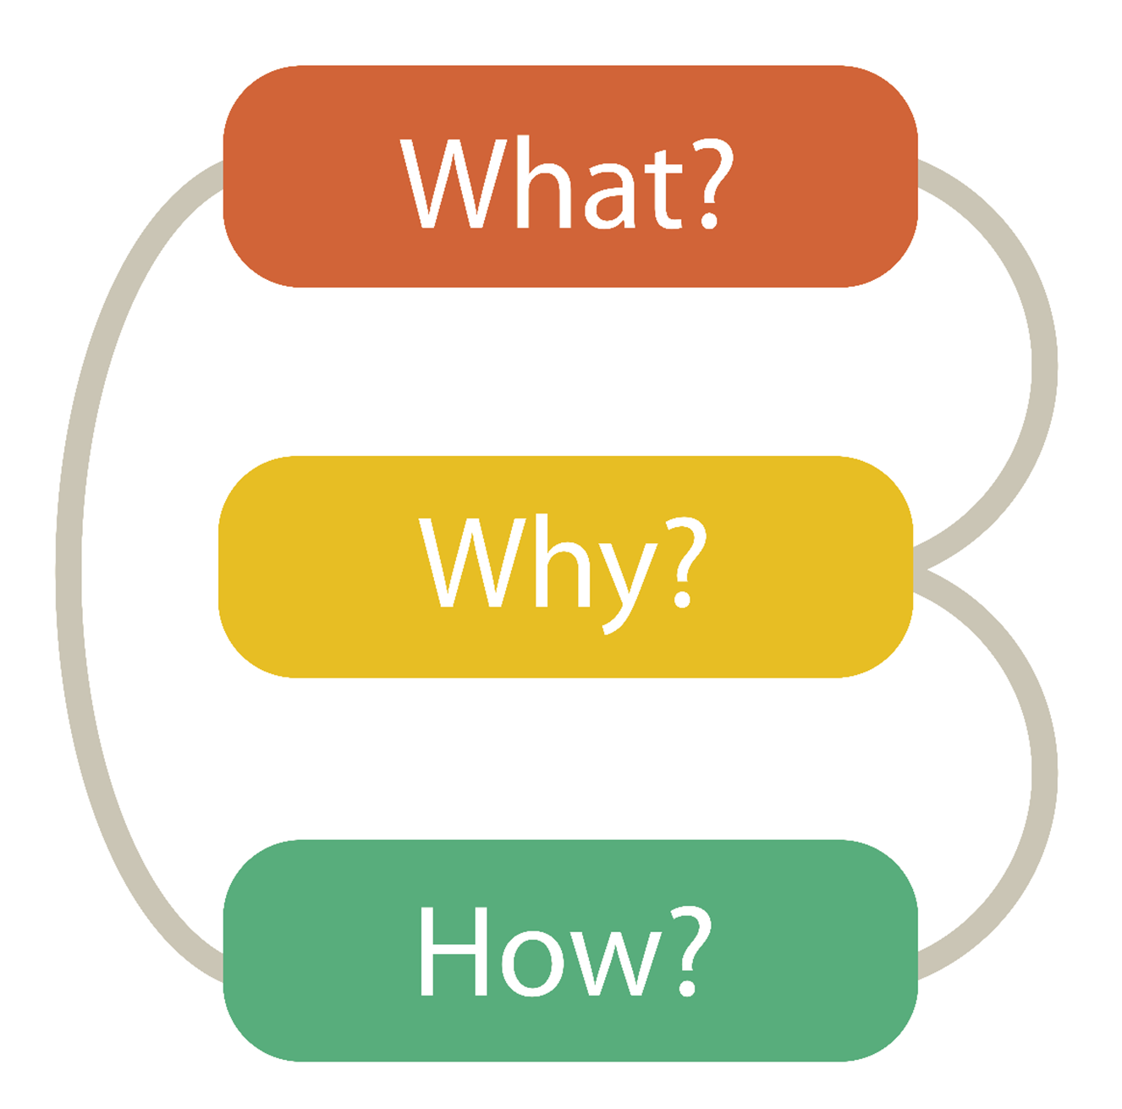

Visualization Building Blocks
Munzner’s Nested Model
Data Abstraction
Task Abstraction
Visual Encoding
Notes:
Last class we talked about the essential building blocks to a visualization tool, which were data, task, and visual encoding.
In other words, what why and how.
We also looked at how these pieces fit into the larger visualization design pipeline.

Slide 6
Visualization Building Blocks
Data Abstraction
Task Abstraction
Visual Encoding

Slide 7
Visual Encoding
From Munzner’s book

Slide 8
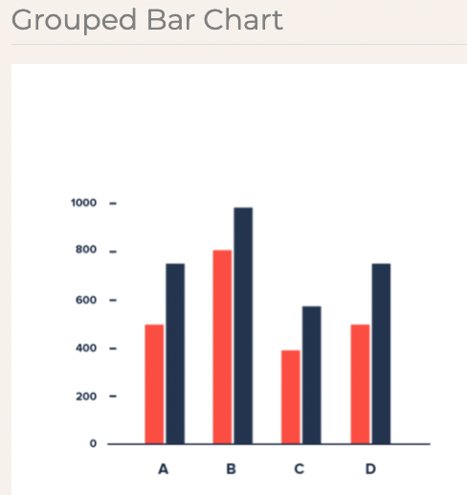
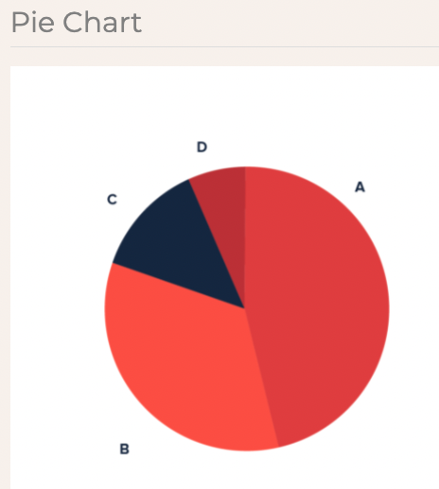
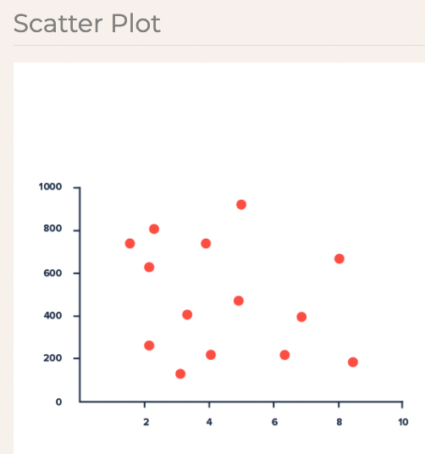
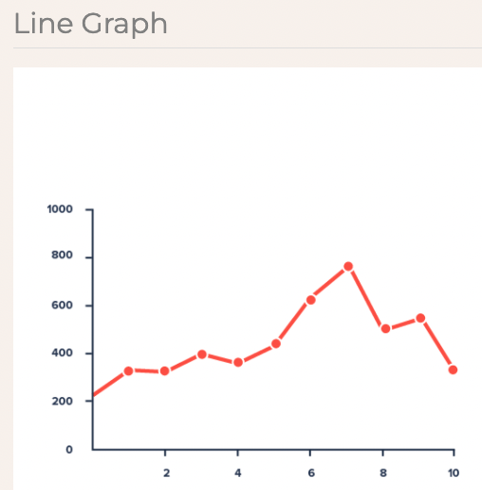
Visual Encoding
What is it?
The literal representation of data in a visualization.
https://datavizproject.com/
Notes:
First off, what is a visual encoding? <read>
So things like bar charts, pie charts, scatter plots, line graphs are all different visual encodings.

Slide 9
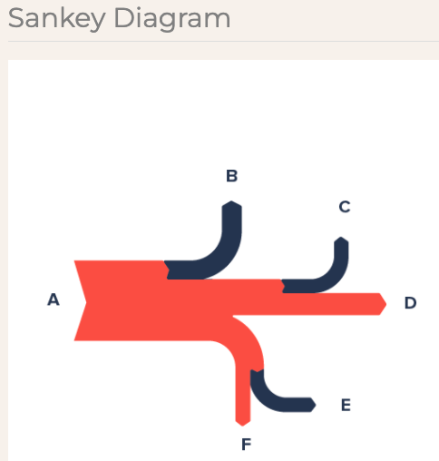
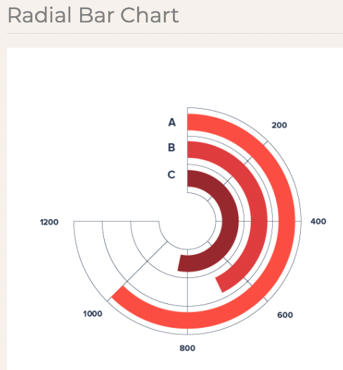
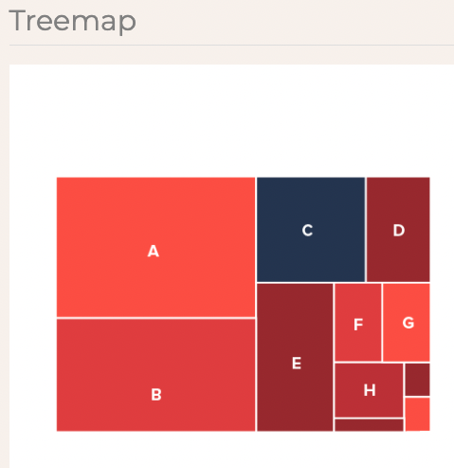
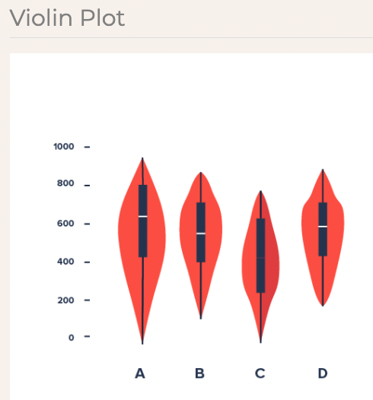
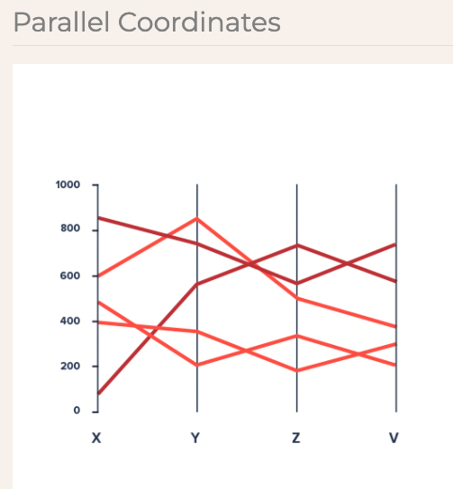
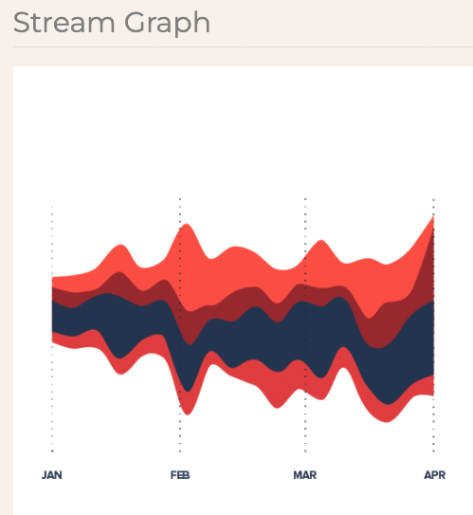
Visual Encoding
What is it?
The literal representation of data in a visualization.
https://datavizproject.com/
Notes:
Sankey visualizes flow
This isn’t limited to the basic plots most people are familiar with, each of these more advanced or niche visualizations are also each a visual encoding.

Slide 10
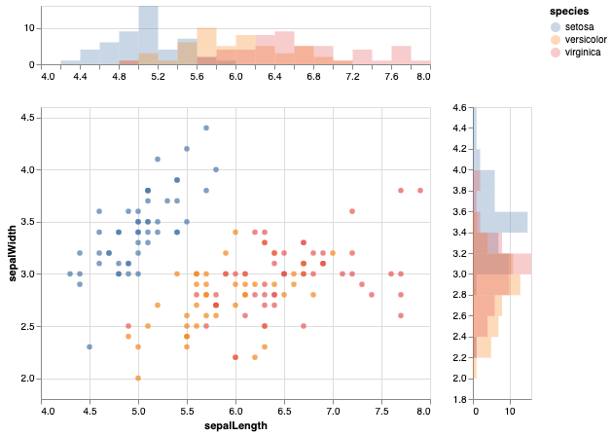
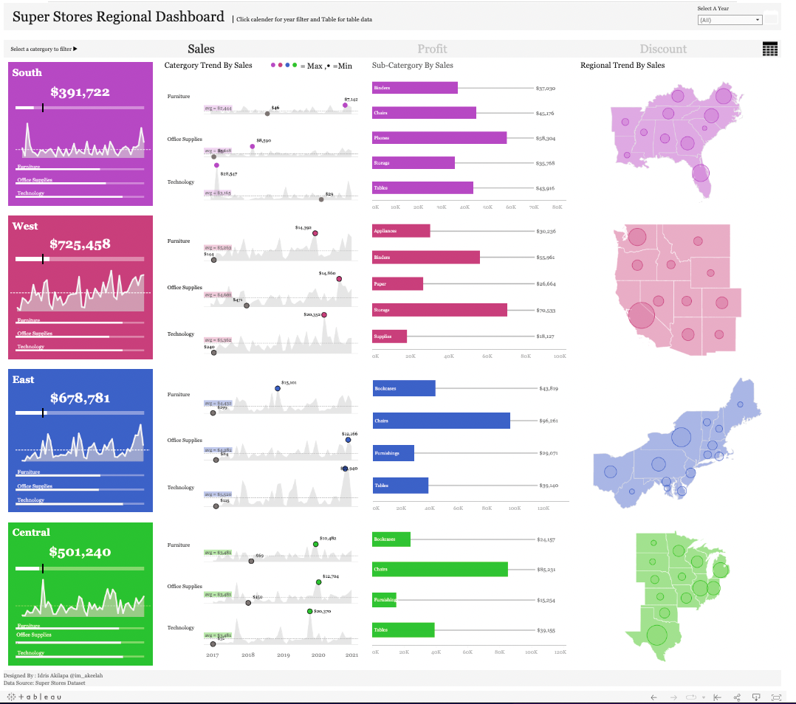
Visual Encoding
What is it?
The literal representation of data in a visualization.
https://altair-viz.github.io/gallery/index.html
https://public.tableau.com/app/profile/akilapa.idris5302/viz/SuperStoresRegionalDashboard/SuperStoreRegionalDashboard
Notes:
When we’re building a complex or speciaplized visualization tool, a lot of times the final visual encoding we come up with is a combination of other visual encodings.
For example, on the left here is a scatter plot and bar charts combined into one encoding.
On the right we see line charts, bar charts, and maps combined into one more complex visual encoding.

Slide 11
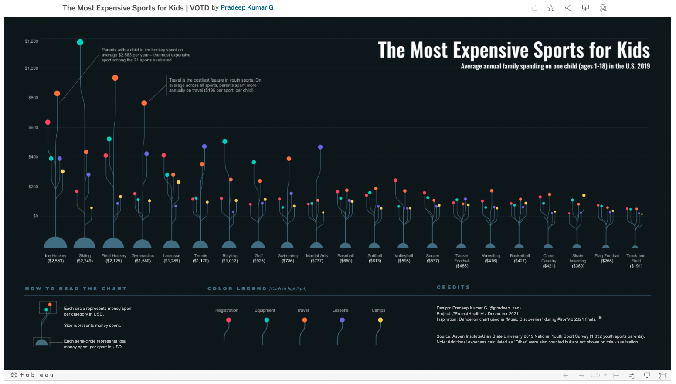
Visual Encoding
What is it?
The literal representation of data in a visualization.
https://public.tableau.com/app/profile/pradeepkumar.g/viz/TheMostExpensiveSportsforKids/ProjectHealthViz
Notes:
When we’re designing a visualization sometime we come up with new or novel visual encodings.
For example, here is a chart that uses a novel visual encoding.

Slide 12
Marks and Channels
From Munzner’s book
Notes:
Now that we’ve defined visual encoding, we need to talk about marks and channels.

Slide 13

Marks and Channels
Marks and Channels = basic visual primitives that make up visualizations
Notes:
Marks and channels are defined as …
You can think of them as the atoms of a visual encoding, the smallest pieces you can break a vis into

Slide 14
Marks and Channels
Marks and Channels = basic visual primitives that make up visualizations
Mark = basic graphical element in an image
Channels = ways to control the appearance of marks
Notes:
Read

Slide 15
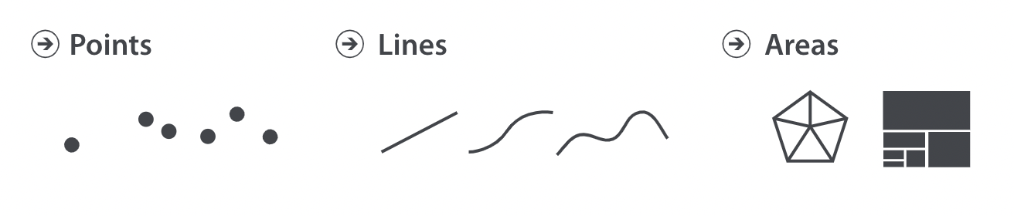
Marks
Mark = basic graphical element in an image
→ 0D
→ 1D (length)
→ 2D (height, width)
Notes:
There are three different types of marks: points, lines, and areas

Slide 16
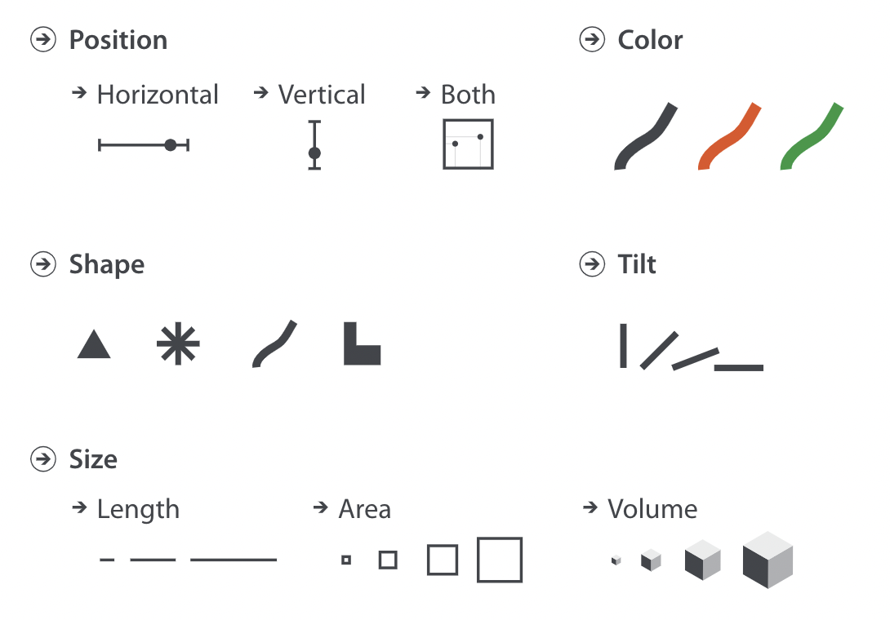
Channels
Channel = way to control the appearance of marks (independent of dimensions)
Notes:
Channels include things like position, color, shape, tilt, and size.

Slide 17
Visual Encoding
Marks
Channels
Visual Encoding
Notes:
By matching different marks and channels, we end up with different visual encodings.

Slide 18
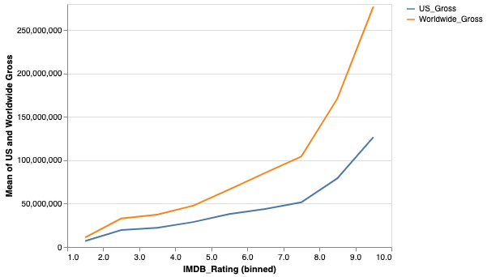

Visual Encoding
Mark
Visual Encoding
(Line chart)
Channels
Notes:
For example, to make our line chart we combine the mark line with the channels color and position.

Slide 19
Visual Encoding
Mark
We can decompose any visualization into marks and channels
Visual Encoding
(Line chart)
Channels
Notes:
Importantly, the marks and channels we select represent the data we are visualizing.
For example here, mark represents an item or trend that we are visualizing, color represent a categorical attribute, and position represents two quantitative attributes.
Let’s look at a few more examples.

Slide 20
Visual Encoding
Notes:
Here I have a bar chart, which is a visual encoding. <next>

Slide 21
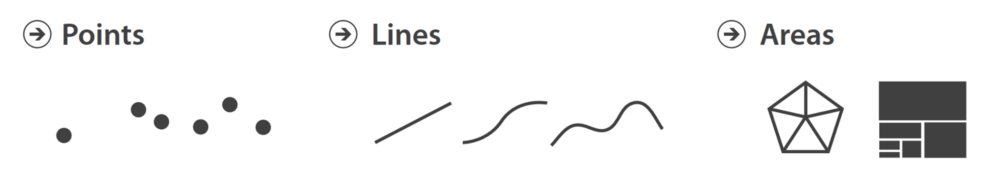
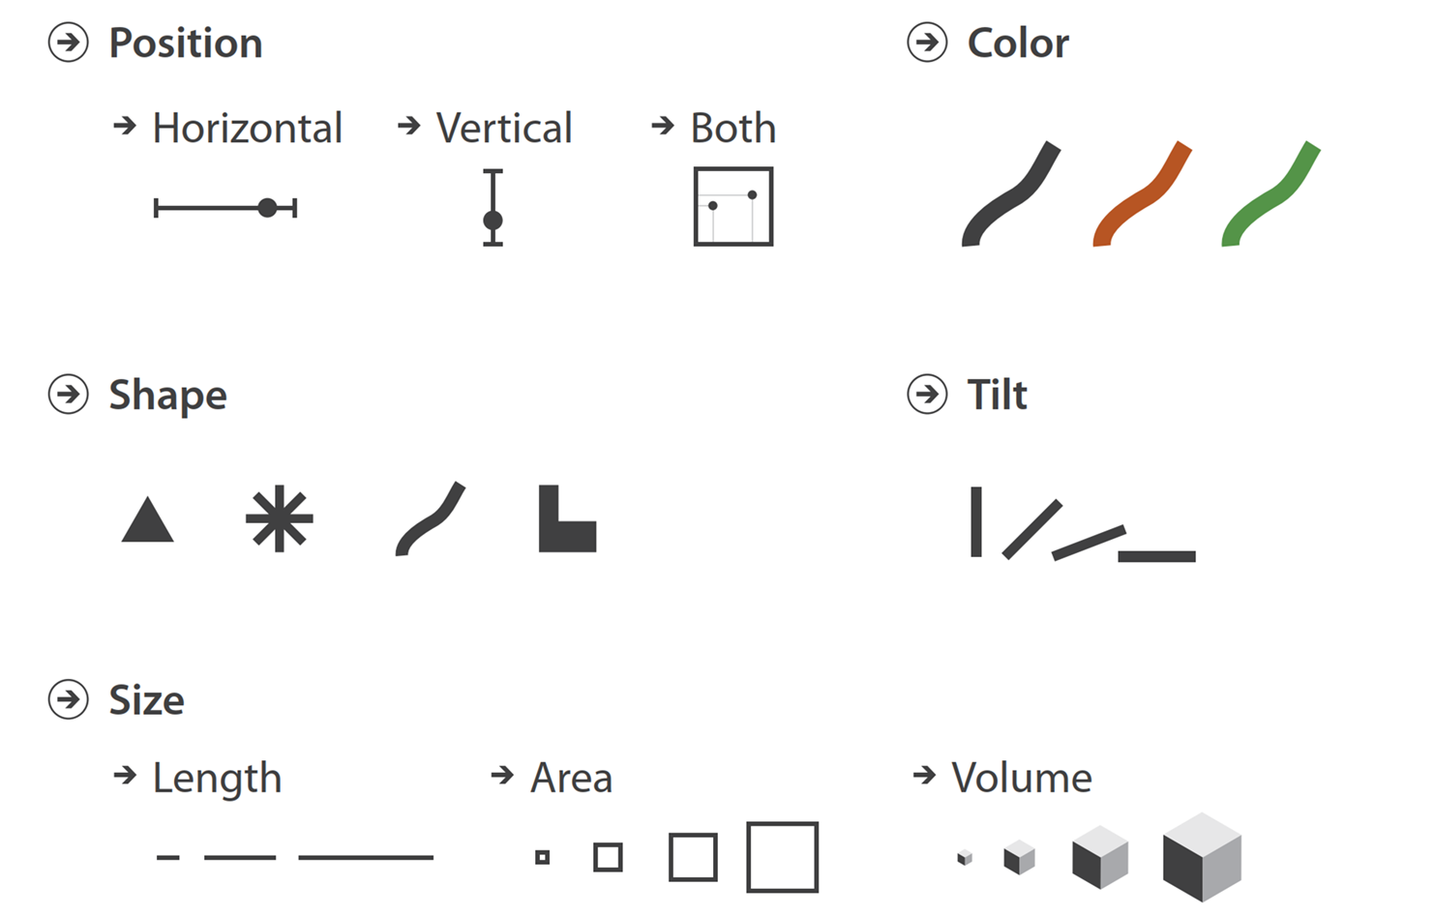
Visual Encoding
Marks
Channels
Notes:
Let’s take this bar chart and break it down into marks and channels. <next>

Slide 22

Visual Encoding
Marks
Channels
Notes:
The marks (or basic graphical elements) on this chart are lines, in this case thick lines. And the channels we’re using are position (horizontal position on the x-axis, and vertical position on the y-axis).
<next>

Slide 23
Visual Encoding
2 Attributes → 2 Channels
Marks
1
Channels
1, 2
2
Notes:
What I want to highlight here, is that each position channel represent a different attribute of the data we’re encoding.
Vertical position represents our attribute named Y, which is quantitative. And
Horizontal position represents our attribute named X, which is categorical.
This demonstrates an important principle of visual encoding design. That is, when we’re designing a visual encoding, we map each attribute that we want to represent to a different channel.
Let’s look at another example.

Slide 24
Visual Encoding
Notes:
Here we have a scatter plot. <next>

Slide 25
Visual Encoding
Marks
Channels
Notes:
Any thoughts on what marks and channels we can break this visual encoding into? <next>

Slide 26
Visual Encoding
Marks
Channels
Notes:
The marks used here are points, and the channels are again both horizontal and vertical position.
Now, let’s think about the attributes we’re showing and their types. Any thoughts on what my attributes are shown in this visualization and their data types?

Slide 27
Visual Encoding
2 Attributes → 2 Channels
Marks
1
Channels
1, 2
2
Notes:
Yes, we have a quantitative attribute shown via vertical position on the y-axis.
And another quantitative attribute shown via horizontal position on the x-axis.
Again, we have two attributes we want to show, and we represent each through a different channel. <next>

Slide 28
Visual Encoding
What if I have a 3rd
attribute to encode?
2 Attributes → 2 Channels
Marks
Channels
Notes:
Thoughts on how we could encode a third attribute?
How about a fourth?
How would their representations via channels need to change given different data types?

Slide 29
Visual Encoding
3 Attributes → 3 Channels
Marks
1
Channels
Z
3
1, 2
3
2
Notes:
Right, so if I want to add another attribute I need to add another channel. In this case, I’ve added a third attribute called Z, that is categorical. And I’ve mapped it to color. So category 1 is blue, and category 2 is green. Any thoughts on a different channel I could have used to represent this third categorical attribute? What if Z was a sequential quantitative variable instead of a categorical one? What if it was diverging?

Slide 30
Visual Encoding
What if I have a 4th
attribute to encode?
3 Attributes → 3 Channels
Marks
1
Channels
3
Z
1, 2
3
2
Notes:
Right, so if I want to add another attribute I need to add another channel. In this case, I’ve added a third attribute called Z, that is categorical. And I’ve mapped it to color. So category 1 is blue, and category 2 is green. Any thoughts on a different channel I could have used to represent this third categorical attribute? What if Z was a sequential quantitative variable instead of a categorical one? What if it was diverging?

Slide 31
Visual Encoding
4 Attributes → 4 Channels
Marks
1
4
Channels
1, 2
3
Z
3
2
4
Notes:
As long as we have appropriate channels left and space we can keep adding attributes to this visual encoding.
Here I’ve added W which is quantitative, and I’ve used area to represent W.
Any questions?

Slide 32
Visual Encoding
Notes:
Next let’s look at this visual encoding. I want all of you to try breaking this one into marks and channels. So…
<next>

Slide 33
Visual Encoding
Marks
Channels
Notes:
Here is the list of marks and channels to help

Slide 34



Visual Encoding
Marks
Channels
Notes:
One “slice” represents 1 data point.
Color encodes X, which is categorical.
Tilt (or area) encodes Y, which is quantitative.

Slide 35

Visual Encoding
2 Attributes → 2 Channels
Marks
Channels
1
2
Y
2
1
X
Notes:
One “slice” represents 1 data point.
Color encodes X, which is categorical.
Tilt (or area) encodes Y, which is quantitative.

Slide 36
Choosing Marks and Channels
From Munzner’s book
Notes:
So we know what types of things we can represent with different marks and channels. Now let’s talk about selecting the best mark or channel out of all your options given a particular data or attribute type.

Slide 37
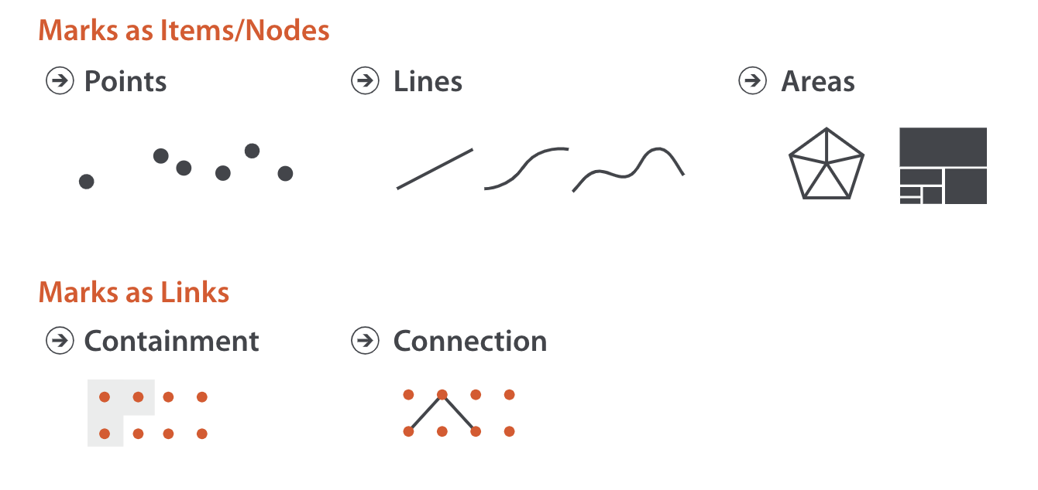
Marks
Work in groups
What types of data or things can you represent with each of these mark types?
Be prepared to share your answers

Slide 38
Marks
Trends
Notes:
To do that we’re going to talk about categorizing.
First off, a note on Mark types. We have points, lines, and areas. In addition to representing an individual data item, marks can represent links, as we’ve seen before.
For example, area can represent containment or hierarchy, and lines can represent connections between items.

Slide 39
Channels

Slide 40
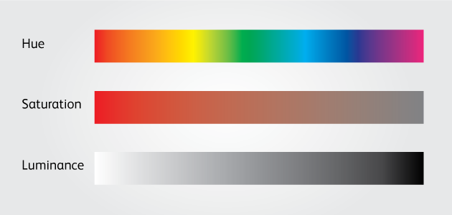
Channels
A note on color:
We consider 3 aspects of color: hue, luminance, and saturation
https://rockcontent.com/blog/building-effective-color-scales/

Slide 41
Channels
Work in groups. Each will be assigned a channel
Use your assigned channel (and only that channel) to encode the following data
(hue,
saturation,
luminance)
Dataset 1
Pear
Apple
Grape
Dataset 2
Sophomore
Junior
Senior
Dataset 3
1.5
7.25
- 3.4

Slide 42
Channels
Based on human perception
Identity
→ What: position, shape, hue (color)
Magnitude
→ How much: position, size,
luminance (color),
saturation (color), tilt
(hue,
saturation,
luminance)
Notes:
Now when we think of categorizing channels, we tend to think about what types of data each can encode.
And the way we determine what each can encode is by thinking about the human perceptual system.
There are three modalities through which we perceive channels: what, where, and how much.
Each channel is differently suited for representing each of these modalities.
For example, what is best represented by shapes, and colors.
Where is best represented by position.
How much is best represented by size, color, and tilt.
What I want to highlight here is that the modality for which each channel is best suited tends to match with the data type of the channel itself.
For example, ”what” something is is a categorical attribute, and shape and color are categorical data as well.
”where” something is can be a quantitative or categorical variable, and position similarly can be categorical or quantitative. (ex. Value on a scale, or I’m in NH vs MA)
“How much” is a quantitative variable, and size, color, and tilt are also quantitative data.

Slide 43
Choosing Marks and Channels
Expressiveness + Effectiveness
Notes:
When choosing marks and channels for a visual encoding we follow what are called the expressiveness and effectiveness principles.
Let’s look at what these two words mean.

Slide 44
Choosing Marks and Channels
Expressiveness Principle = The visual encoding should express all of, and only, the information in the dataset attributes.
i.e. The perceptual interpretation of channels (identity vs. magnitude) should match the interpretation of data.
Notes:
The expressiveness principle is defined in this way: ….
This is what we alluded to earlier when we looked at categorizing channels according to the modality by which they are typically perceived.
A categorical variable should be shown with a what (or categorical) channel, like color (hue) or shape.
A quantitative variable should be shown with a how much (or quantitative) channel, like color (saturation) or size.

Slide 45
Choosing Marks and Channels
Expressiveness Principle = The visual encoding should express all of, and only, the information in the dataset attributes.
i.e. The perceptual interpretation of channels (identity vs. magnitude) should match the interpretation of data.
Dataset 1
Pear
Apple
Grape
Categorical – Identity
Grape
Grape
Pear
Pear
Apple
Pear
Grape
Apple
Apple
Notes:
Mark = Area

Slide 46
Choosing Marks and Channels
Expressiveness Principle = The visual encoding should express all of, and only, the information in the dataset attributes.
i.e. The perceptual interpretation of channels (identity vs. magnitude) should match the interpretation of data.
Dataset 3
1.5
7.25
- 3.4
Quantitative – Magnitude
-3.4
-3.4
-3.4
1.5
1.5
1.5
-3.4
1.5
7.25
7.25
7.25
7.25
Notes:
Mark = Point
Position, Size, Luminance, Saturation

Slide 47
Choosing Marks and Channels
Expressiveness Principle = The visual encoding should express all of, and only, the information in the dataset attributes.
i.e. The perceptual interpretation of channels (identity vs. magnitude) should match the interpretation of data.
Dataset 2
Sophomore
Junior
Senior
Ordinal – Identity / Magnitude
Sophomore
Sophomore
Junior
Junior
Senior
Junior
Sophomore
Senior
Senior
Notes:
The expressiveness principle is defined in this way: ….
This is what we alluded to earlier when we looked at categorizing channels according to the modality by which they are typically perceived.
A categorical variable should be shown with a what (or categorical) channel, like color (hue) or shape.
A quantitative variable should be shown with a how much (or quantitative) channel, like color (saturation) or size.

Slide 48
Choosing Marks and Channels
Effectiveness Principle = The salience (noticeability) of channels used in the visual encoding should match the importance of attributes.
- i.e. More important attributes should be encoded with more effective channels.
Notes:
The effectiveness principle is defined this way … <next>

Slide 49
Choosing Marks and Channels
Effectiveness Principle = The salience (noticeability) of channels used in the visual encoding should match the importance of attributes.
- i.e. More important attributes should be encoded with more effective channels.
Notes:
So this definition is a bit frustrating, because it essentially uses the work effective in the definition for effectiveness. So what exactly are we talking about here? <next>

Slide 50
Effectiveness
Effectiveness = Based on a compilation of research, how well a channel supports:
Accuracy
Discriminability
Separability
Visual popout
Grouping
Notes:
What this principle boils down to is considering how well each channel supports these things: ..
Let’s define each of these.

Slide 51
Accuracy
Definition: how close human perceptual judgement is to an objective measurement of the stimulus

Slide 52
Accuracy
Definition: how close human perceptual judgement is to an objective measurement of the stimulus
How much longer is the second bar?

Slide 53
Accuracy
Definition: how close human perceptual judgement is to an objective measurement of the stimulus
How much longer is the second bar?
2X

Slide 54
Accuracy
Definition: how close human perceptual judgement is to an objective measurement of the stimulus
How much bigger is the second square?

Slide 55
Accuracy
Definition: how close human perceptual judgement is to an objective measurement of the stimulus
How much bigger is the second square?
4X

Slide 56
Accuracy
Definition: how close human perceptual judgement is to an objective measurement of the stimulus
How much bigger is the second box?

Slide 57
Accuracy
Definition: how close human perceptual judgement is to an objective measurement of the stimulus
How much bigger is the second box?
27X

Slide 58
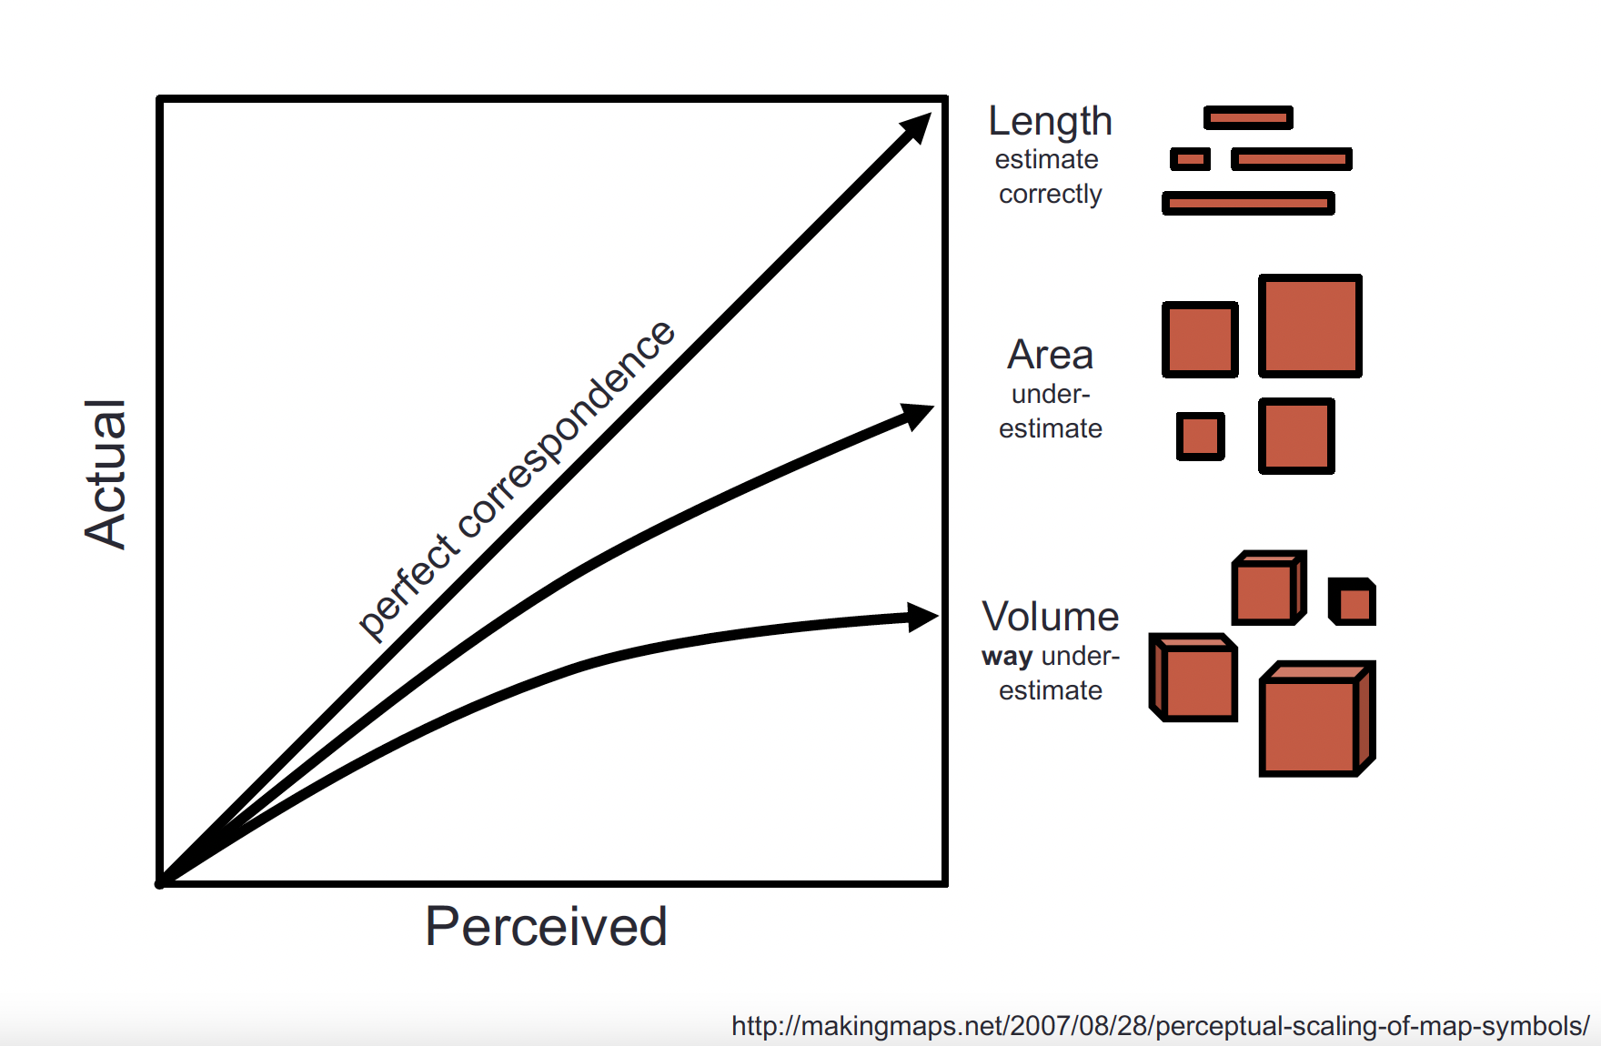
Accuracy
Definition: how close human perceptual judgement is to an objective measurement of the stimulus

Slide 59
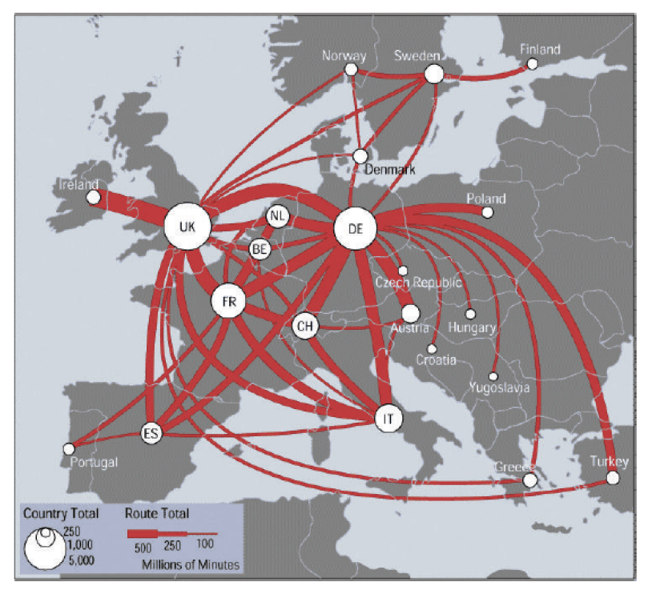
Discriminability
Definition: how differentiable levels of the channel are
https://web.cse.ohio-state.edu/~shen.94/Melbourne/Slides/TamaraChp5.pdf

Slide 60
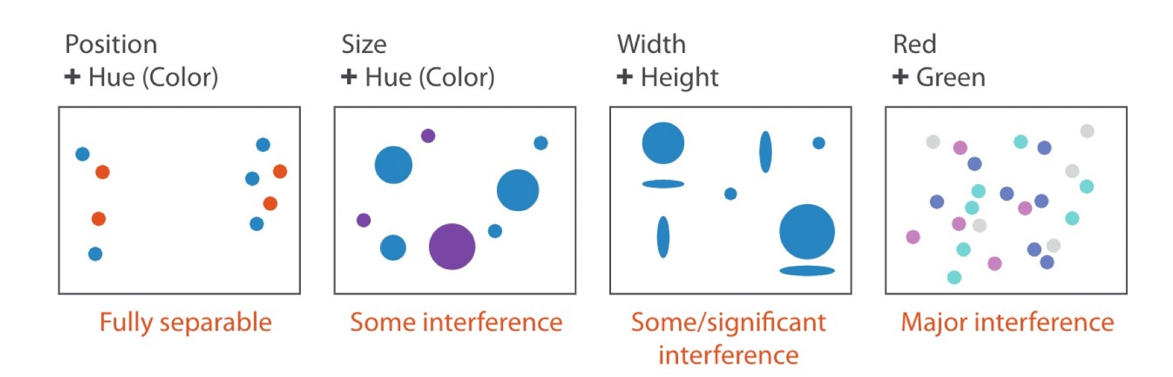
Separability
Definition: whether channels exist independently or integrally with others
(saturation)

Slide 61
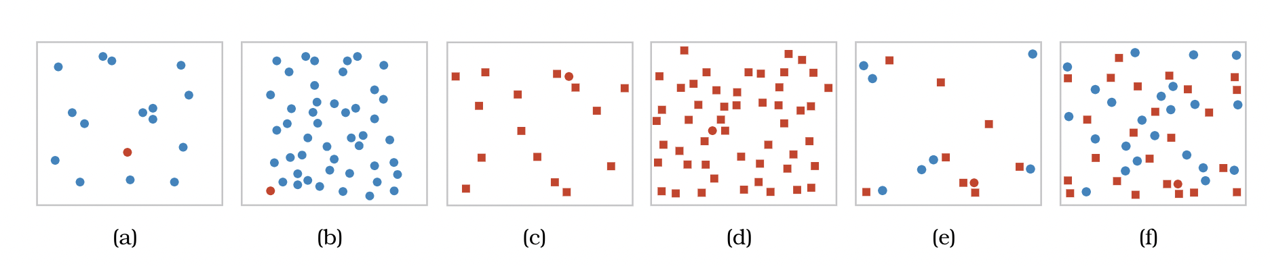
Visual Popout
Definition: how well a distinct item stands out from others

Slide 62
Visual Popout
Definition: how well a distinct item stands out from others
Color is a good channel for this

Slide 63
Visual Popout
Definition: how well a distinct item stands out from others

Slide 64
Visual Popout
Definition: how well a distinct item stands out from others
Shape is not as helpful

Slide 65
Visual Popout
Definition: how well a distinct item stands out from others

Slide 66
Visual Popout
Definition: how well a distinct item stands out from others
Combining color and shape causes “competition” – color is processed first

Slide 67
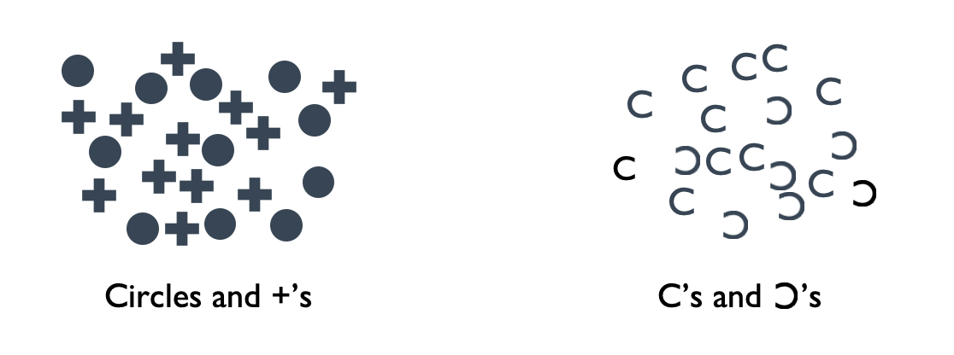
Grouping
Definition: how likely people are to infer differences as representing distinct groups

Slide 68
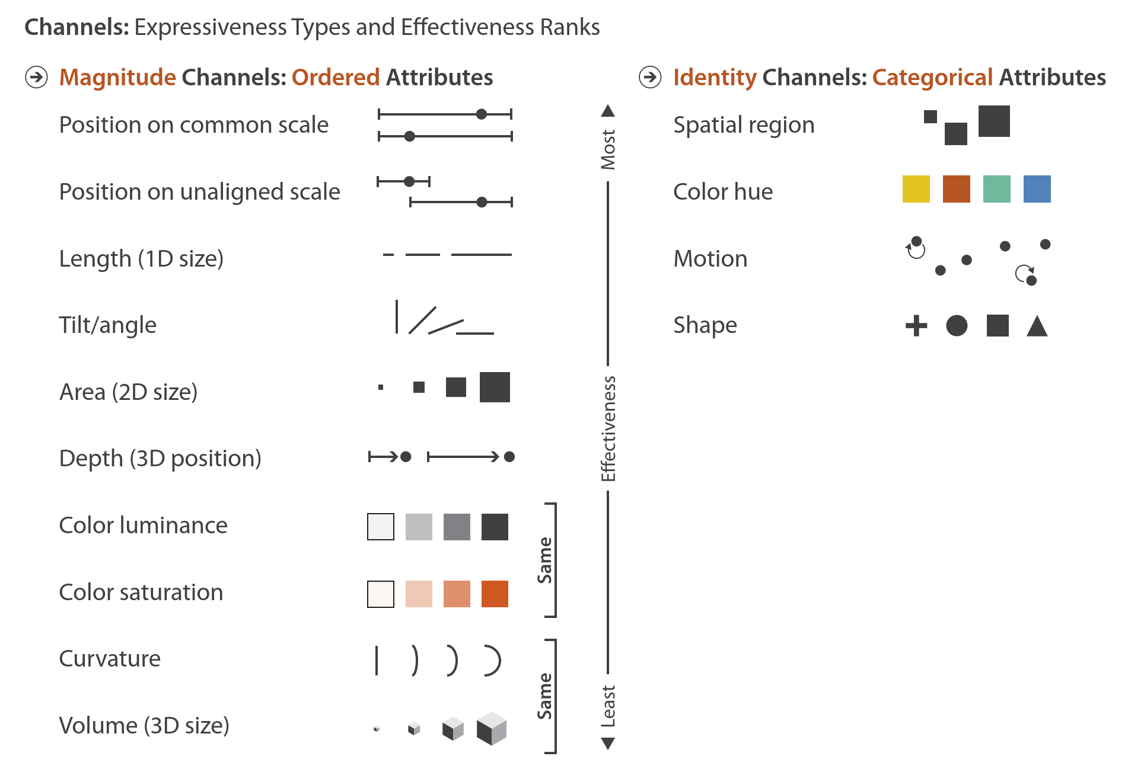
Expressiveness + Effectiveness
Notes:
So, that was a lot of different definitions of things that go into effectiveness. If we sum it all together, we get these rankings for our various channels based on expressiveness and effectiveness.
On the left here you see channels well suited to showing ordered or quantitative attributes, ranked from more effective to least. On the right you see channels well suited to showing categorical attributes, again ordered from most to least effective.

Slide 69
Let’s take a break! Stretch, go for a walk, be social ☺ Be back here in 10 mins.

Slide 70
Decomposing Graphics

Slide 71
Summary
Today we:
Reviewed Marks and Channels
Reviewed Expressiveness and Effectiveness
Worked on ic-04 (Decomposing Graphics)
ic-04 is DUE today.
hw-03 and pm-01 are OUT today.

